Slide 1
Power Wyoming
Overview
January 28, 2020

Slide 2
Knowledge is Power
“Wyoming is blessed to have such incredible energy resources,” Gov. Gordon said. “We need to position ourselves to plan for changes in energy production.”
The plan:
1. Model the production scenarios and then the economic impact. Using multiple sources of data.
2. Model the revenue impacts.
3. Develop data on nearby states tax structures.
4. Show how policy changes could affect Wyoming.
  These are both federal policies and state policies. Internal and external state policies.
5. Prepare for how these scenarios play out in local communities.

Slide 3
First Round of Analysis
The group’s analysis indicates the state faces several years of declining revenues that will need to be addressed, along with the possibility of a return to oil-based revenues in the long-term. The data show that it is unlikely that Wyoming can continue to rely on a combination of coal, natural gas and oil revenues to sustain itself in the long-term. It also modeled a decline in population and jobs in the near term.

Slide 4
Where our money comes from now

Slide 5
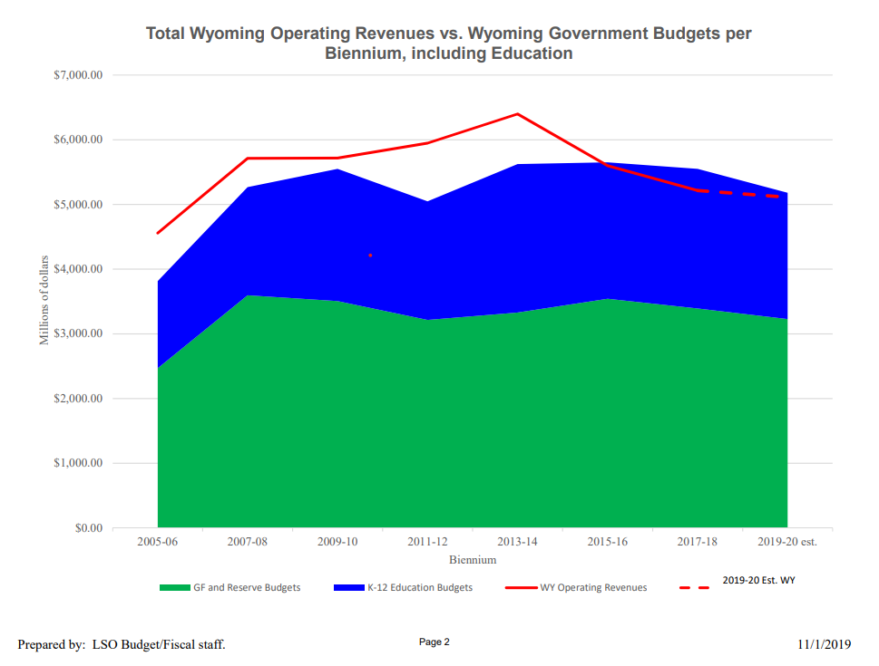
Fiscal Storm is Here

Slide 6
Personal Taxes vs. Public Service Costs in Wyoming: 2018
For a 3-person family with income of $60,000 and owning a home with value of $220,000
Retail Sales | $900
Gasoline | $220
Cigarettes | $110
Alcohol | $90
Vehicle Registration | $460
Property Tax | $1,400
TOTAL: | $3,180
County | $2,970
City/Town | $3,320
Special District | $5,310
K12 Education | $7,320
State Services | $8,130
TOTAL: | $27,050
Source: Wyoming Economic Analysis Division
Note: Exclude Federal funds and enterprise revenue
Notes:
I created this chart about 10 years ago.
Buck McVeigh takes it to many Legislative Committees, and now it’s getting everywhere, and most legislators know its existence.
It’s also get to Governor’s ENDOW report.

Slide 9
Property Values, by Category
Property Valuation by Category 2008
Property Valuation by Category 2018

Slide 10
Where Property taxes go.

Slide 12
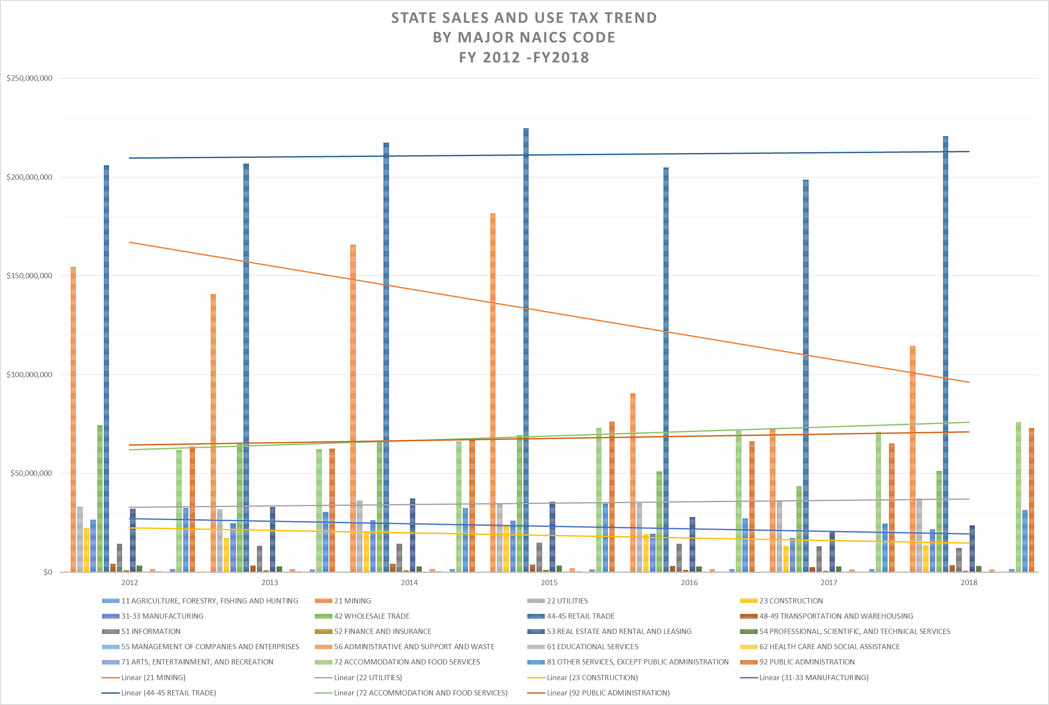

Slide 13
Trends in Energy Production

Slide 14
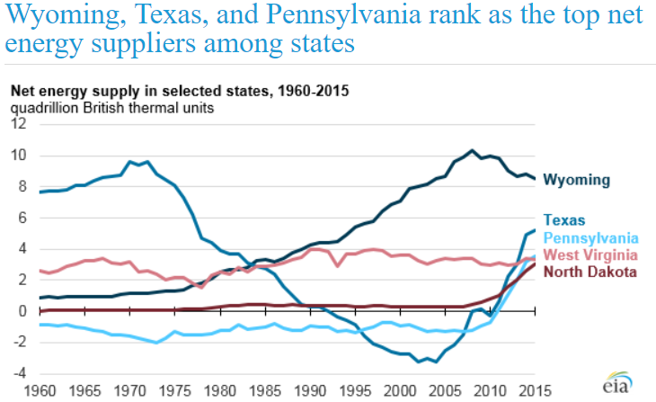
Wyoming Exports Nearly All of Its Energy
Source: EIA, State Energy Data System (July 31, 2017) (available at https://www.eia.gov/todayinenergy/detail.php?id=32272)

Slide 15
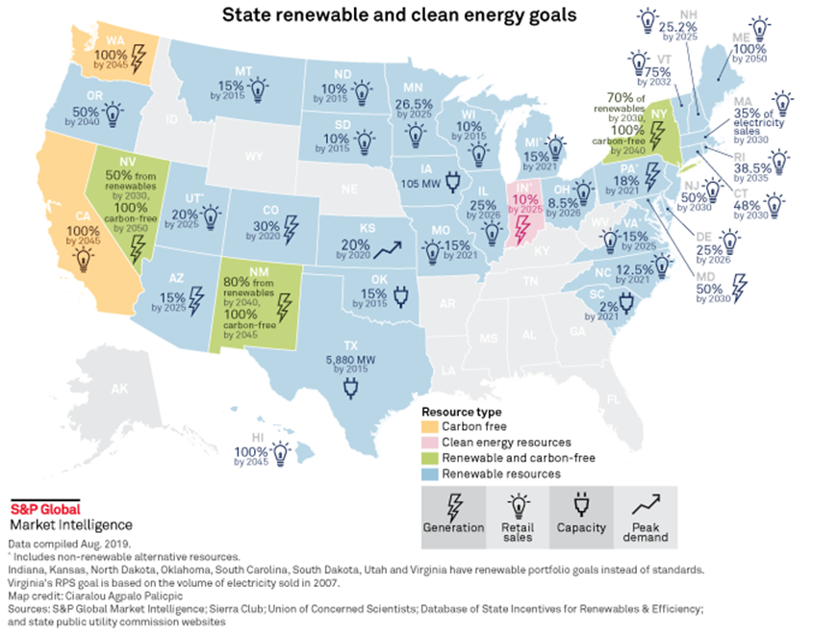
State Low-Carbon Policies Are Expanding
Source: S&P

Slide 16
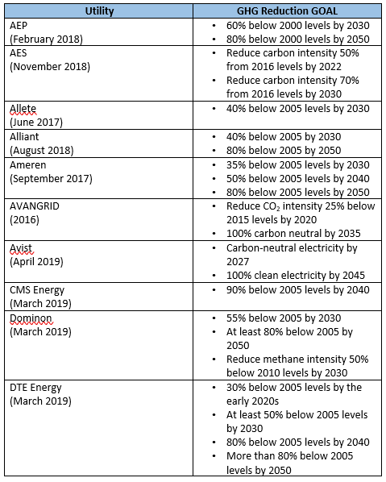
Private Sector Involved Too:
Source: Utility web sites, public statements

Slide 17
General Trends: 2030 and Beyond
General Trends for Electricity Generation
  Policies being put in place in many States to de-carbonize in the 2035-2050 window
  It feels as if natural gas is where coal was about 20 years ago or so; California, for example, is exploring how to back-out gas in lieu of grid-scale storage
  The role of BECCS/CCS/CCUS is in play
  CDR technologies are growing in importance
General Trends for Transportation Fuels
  Vehicles -- Push is on for electricity as a transportation fuel, driven in part by decarbonization considerations; some countries in Europe have enacted future bans on the internal combustion engine; could electrification provide a business opportunity for zero-carbon coal?
  Aviation – Pilot phase of the ICAO “Carbon Offsetting & Reduction Scheme for International Aviation” starts to roll out
  Maritime – Last year IMO adopted a strategy that largely aligns the shipping industry with the Paris Agreement
  It feels as if oil is where coal was about 20-30 years ago
General Trends for Industrials, Steel, Cement, Other
  Taking a hard look at CCS/CCUS; also considering other technologies to decarbonize

